Slide 1
Boeing Drone: 33% Build Update
Project 03
Team Hi-Jacks
Damien Brothers, Dante Faria, Jay Khunt,
Colby Murphy, and Thomas Schreiber

Slide 2

Project Description
Design, analyze, and manufacture a 3D printed drone frame that minimizes weight and maximizes flight time using set commercially available components.​
Sponsor: Boeing ​
Frame under 3 pounds.​
Maximize flight time.
Material stress testing/simulation.
2, Damien

Slide 3
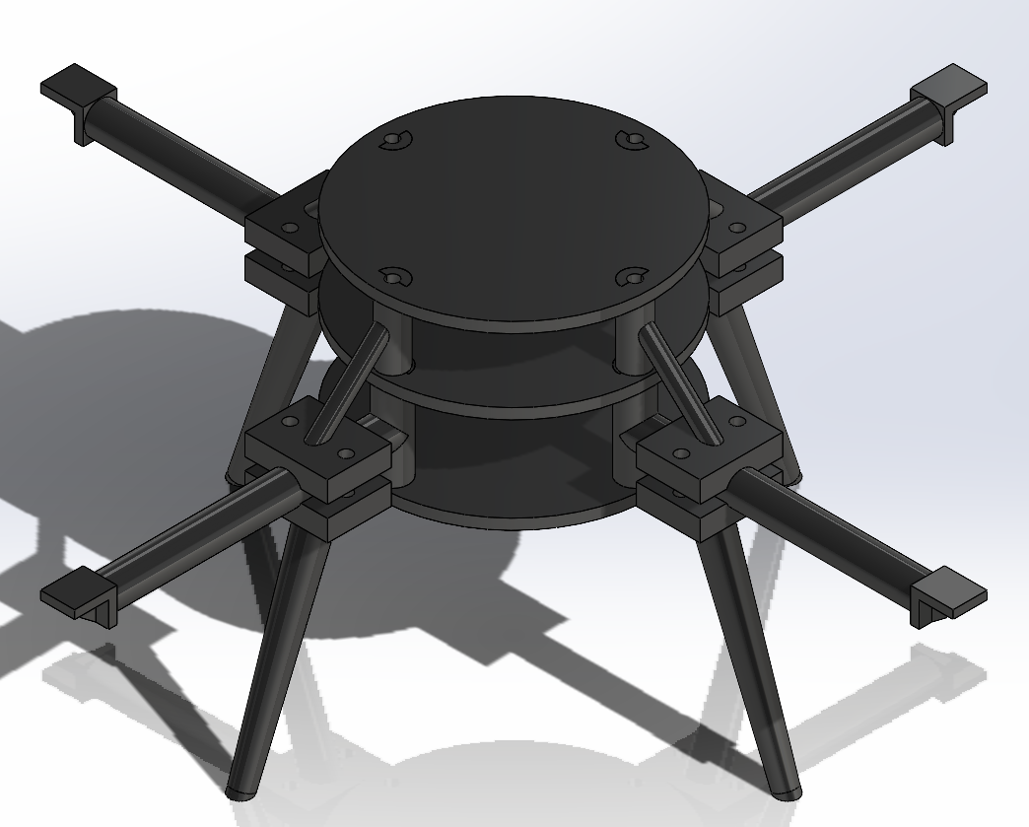
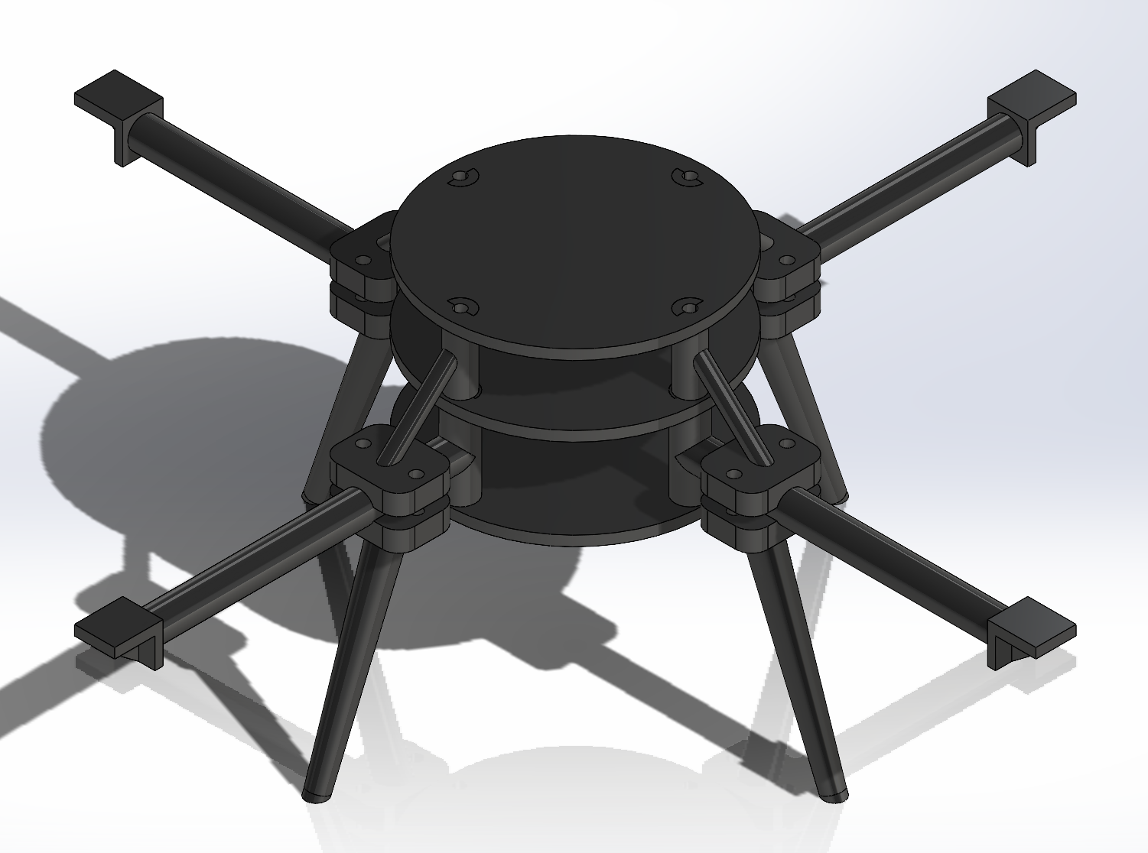
Design Efforts
Start of Semester:
Current:
Will iterate on component attachments.
Have updated motor mounts, leg attachments, and arm length.
Engineering model has remained the same.
3, Damien

Slide 4
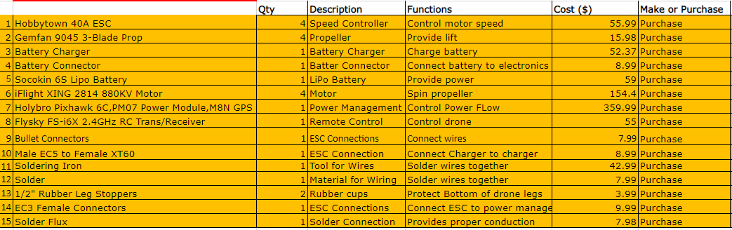
Purchasing Plan 1/2
4, Colby

Slide 5
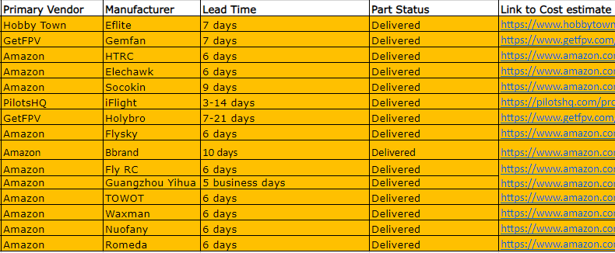
Purchasing Plan 2/2
$1400 used out of $5000
All parts have been ordered and received
Remaining Purchases:
3D printing parts (Idea lab and Hubs.com)
Parts damaged in testing
Gasoline to visit our clients
5, Colby

Slide 6
Manufacturing Plan
Manufactured (3D printed):
Plates
Legs
Arms
Spacers and Connectors
Assembly line:
Started with electrical connections
Connection for one motor is done along with flight controller and receivers
Yet to manufacture:
Arms (increase size according to placement of propellors)
Plates (if needed to increase space for placement of parts)
6, Jay

Slide 7
Bill of Materials (Printed Parts)
Part | PCS. | Item No | Item Description | Weight [g] | U/M | W-C | What | Where | Cost ($)
1 | 3 | 22F-001 | ONYX 3D Printed Plate W/ Key | 183 | SQFT | FAB | ONYX | IDEA Lab | 35
3 | 4 | 22F-003 | ONYX 3D Printed Arm W/Spacer | 108 | SQFT | FAB | ONYX | Hubs | 178.12
4 | 4 | 22F-004 | ONYX 3D Printed Leg W/Arm Clamp | 76 | SQFT | FAB | ONYX | Hubs | 119.08
5 | 4 | 22F-005 | ONYX 3D Printed Spacer W/Arm Clamp | 60 | SQFT | FAB | ONYX | Hubs | 76.16
7, Jay

Slide 8
Bill of Materials (Purchased Parts)
8, Jay
 |  | Qty | Description | Functions | Cost ($) | Make or Purchase | Primary Vendor | Manufacturer | Lead Time | Part Status
1 | Hobbytown 40A ESC | 4 | Speed Controller | Control motor speed | 55.99 | Purchase | Hobby Town | Eflite | 7 days | Delivered
2 | Gemfan 9045 3-Blade Prop | 4 | Propeller | Provide lift | 15.98 | Purchase | GetFPV | Gemfan | 7 days | Delivered
3 | Battery Charger | 1 | Battery Charger | Charge battery | 52.37 | Purchase | Amazon | HTRC | 6 days | Delivered
4 | Battery Connector | 1 | Batter Connector | Connect battery to electronics | 8.99 | Purchase | Amazon | Elechawk | 6 days | Delivered
5 | Socokin 6S Lipo Battery | 1 | LiPo Battery | Provide power | 59 | Purchase | Amazon | Socokin | 9 days | Delivered
6 | iFlight XING 2814 880KV Motor | 4 | Motor | Spin propeller | 154.4 | Purchase | PilotsHQ | iFlight | 3-14 days | Delivered
7 | Holybro Pixhawk 6C,PM07 Power Module,M8N GPS | 1 | Power Management | Control Power FLow | 359.99 | Purchase | GetFPV | Holybro | 7-21 days | Delivered
8 | Flysky FS-i6X 2.4GHz RC Trans/Receiver | 1 | Remote Control | Control drone | 55 | Purchase | Amazon | Flysky | 6 days | Delivered
9 | Bullet Connectors | 1 | ESC Connections | Connect wires | 7.99 | Purchase | Amazon | Bbrand | 10 days | Delivered
10 | Male EC5 to Female XT60 | 1 | ESC Connection | Connect Charger to charger | 8.99 | Purchase | Amazon | Fly RC | 6 days | Delivered
11 | Soldering Iron | 1 | Tool for Wires | Solder wires together | 42.99 | Purchase | Amazon | Guangzhou Yihua Electric Equipment Co. | 5 business days | Delivered
12 | Solder | 1 | Material for Wiring | Solder wires together | 7.99 | Purchase | Amazon | TOWOT | 6 days | Delivered
13 | 1/2" Rubber Leg Stoppers | 2 | Rubber cups | Protect Bottom of drone legs | 3.99 | Purchase | Amazon | Waxman | 6 days | Delivered
14 | EC3 Female Connectors | 1 | ESC Connections | Connect ESC to power manage | 9.99 | Purchase | Amazon | Nuofany | 6 days | Delivered
15 | Solder Flux | 1 | Solder Connection | Provides proper conduction | 7.98 | Purchase | Amazon | Romeda | 6 days | Delivered

Slide 9
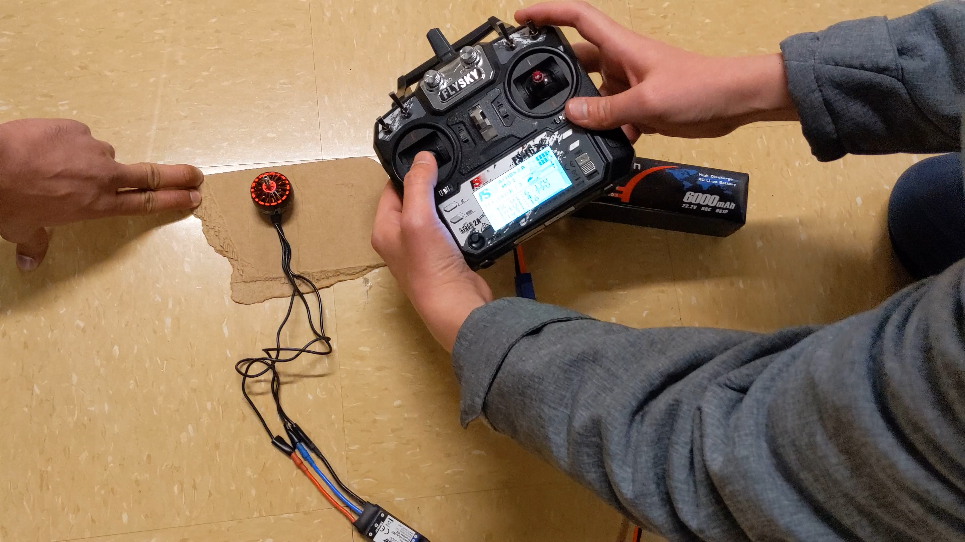
Demonstration
Currently 1 motor spinning
Need to solder other 3 and will hopefully behave the same with 2 spinning in opposite direction
Won’t reach 100% RPM
9, Tommy

Slide 10
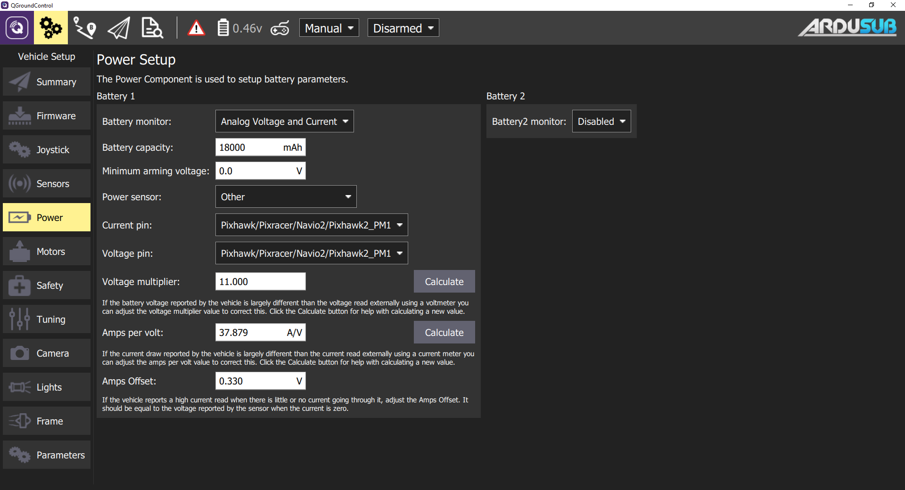
QGroundControl
Used to setup controller
Monitor power outputs
Motor restrictions
Flight setup
GPS tracking
10, Tommy

Slide 11
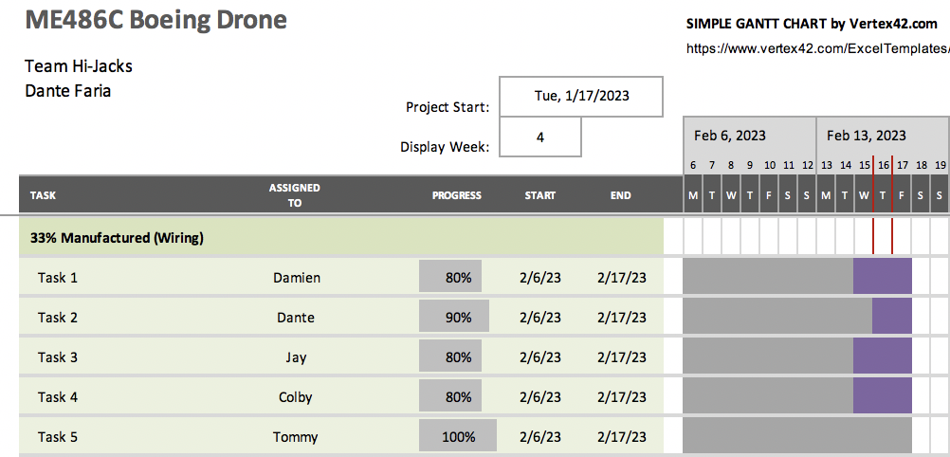
Gantt Chart (Current)
Wiring for one motor is complete and working
Other three just need to be soldered and tested
Diagonal motors need to spin the same direction but opposite other diagonal
Ensure that controller is working properly
11, Dante

Slide 12
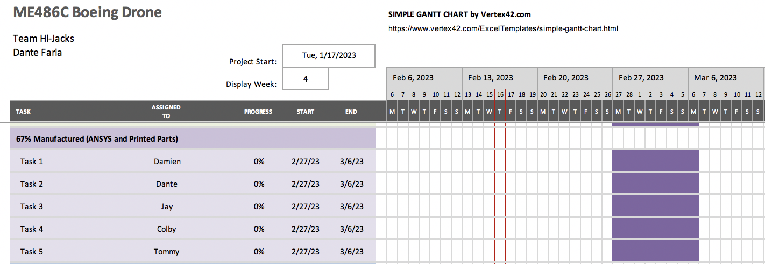
Gantt Chart (Future)
Finish Final CAD and ensure every part has a place
Future deliverable: 67% Manufactured
Run a FEA Analysis (ANSYS) on the frame and begin printing final parts
Reduce weight by decreasing infill of parts to be printed if experiencing little stress
12, Dante

